Slide 1
Transfer Learning for Image Classification Development of a Hybrid Model
Name: Nitin Mundakkil
Student ID: 15124755
MSc Data Science & Computational Intelligence
Supervisor: Anuja Talekar
Date:3rd April 2025

Slide 2
Research Overview
Broad Subject Area: Deep learning and convolutional neural networks for image classification
Narrow Topic Area: Transfer learning with hybrid model development
Research Focus: Developing and optimizing hybrid CNN model that combines multiple pre-trained models
Key Innovation: Systematic integration of complementary features using attention mechanisms
A “TRANS – EMBLE” (Transformer + Ensemble) Approach

Slide 3
Problem Statement & Research Question
Problem:
Individual pre-trained models deliver suboptimal results for specialized tasks
Building models from scratch requires enormous labeled data and computational resources
Existing transfer learning approaches often underutilize complementary strengths of different architectures
Research Question:
"How can a hybrid CNN model leveraging transfer learning from pre-trained networks be developed and optimized to improve accuracy and computation speed compared to individual models?"

Slide 4

Research Objectives
Primary Aim: Develop an optimized hybrid CNN model combining multiple pre-trained architectures
Specific Objectives:
Extensive review of transfer learning methodologies and its usages
Design and implement a hybrid architecture that effectively combines features from multiple pre-trained models
Develop systematic evaluation metrics comparing hybrid vs. individual models

Slide 5

Literature Review - Theoretical Foundations Key Contributions to Transfer Learning and Hybrid CNNs
Transfer Learning Theory:
Pan & Yang (2010): Established a fundamental transfer learning taxonomy
Weiss et al. (2016): Categorized approaches as instance, feature, parameter, and relational transfer
Architecture Analysis:
He et al. (2016): Residual learning in ResNet enables deeper architectures
Howard et al. (2017): MobileNets achieve efficiency through depth-wise separable convolutions
Hybrid Approaches:
Feichtenhofer et al. (2016): Early work on two-stream network fusion
Woo et al. (2018): Attention mechanisms improve feature integration
Domain Applications:
Medical Imaging
Fine-grained Visual Classification
Remote Sensing Image Analysis

Slide 6
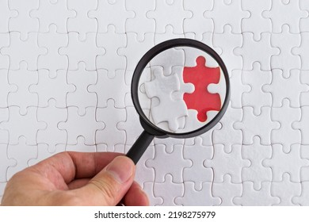
Research Gaps
Gap 1: Architecture-Specific Feature Complementarity
Limited understanding of how different architectures contribute complementary features
Kornblith et al. (2019) shows better ImageNet models transfer better, but doesn't address feature complementarity
Gap 2: Inefficient Feature Integration
Most approaches use simplistic feature fusion (concatenation/summation)
Semantic differences between features from different networks are ignored
Gap 3: Accuracy vs. Efficiency Trade-off
Limited research on optimizing both performance and computational efficiency in hybrid models

Slide 7
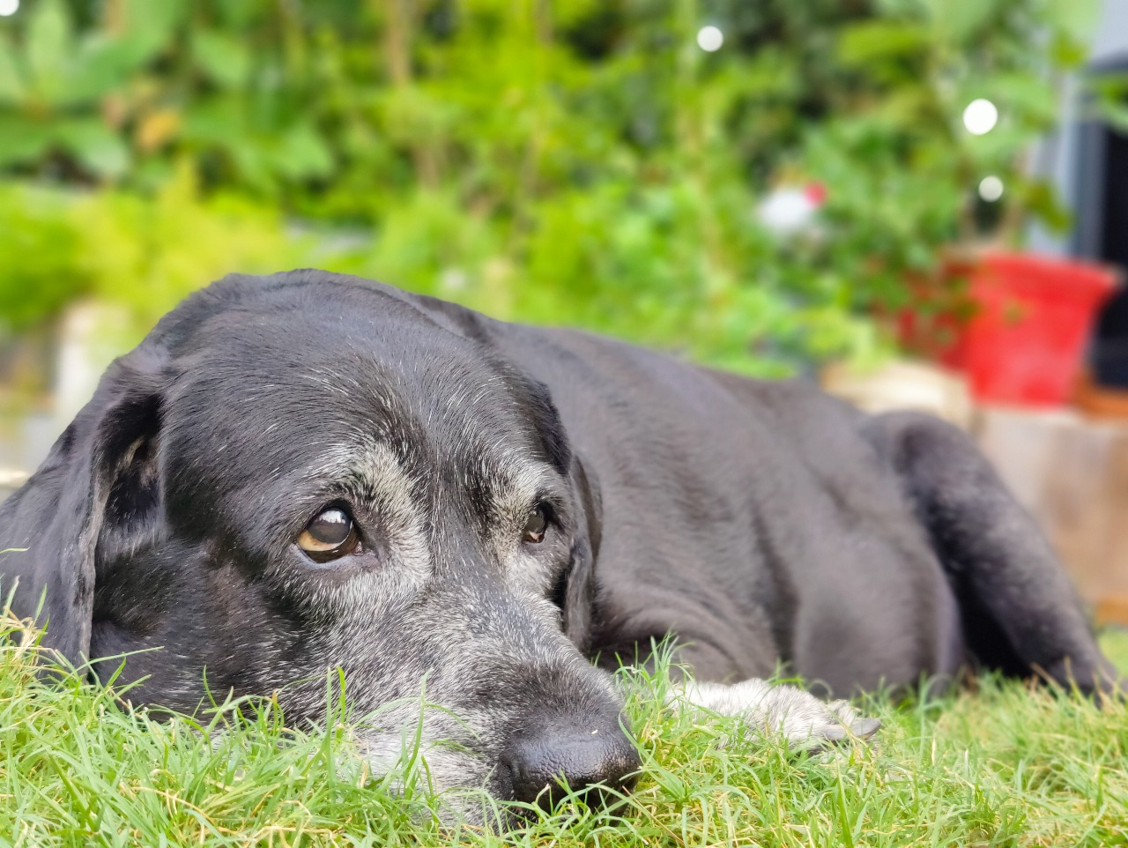

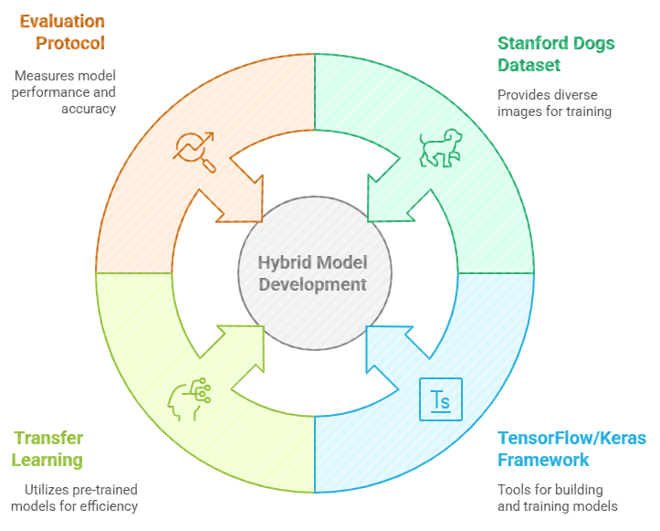
Methodology - Dataset & Evaluation
Dataset: Stanford Dogs Dataset
20,580 images across 120 dog breeds
Challenging fine-grained classification task
Significant variations in pose, lighting, and background
Implementation Framework:
Feature extraction from pre-trained models (MobileNetV2, ResNet50, VGG16)
Structural modifications to retrieve significant feature maps
Feature combination methods (concatenation, weighted averaging)
TensorFlow/Keras for model development
Python implementation with TensorFlow/Keras
Evaluation Protocol:
Comparison with individual pre-trained models
Accuracy as primary metric
Inference time considerations

Slide 8
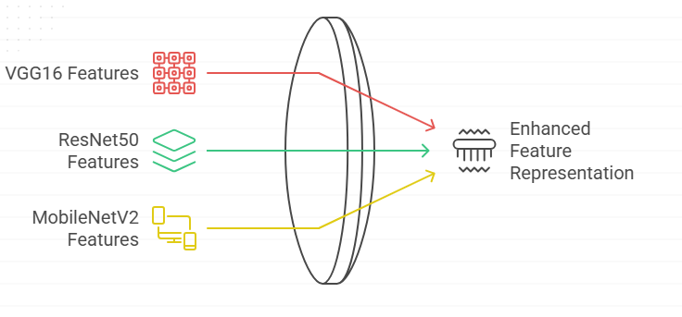
Initial Implementation - 3-Model Hybrid Architecture
Multi-Architecture Feature Extraction:
Three pre-trained networks:
VGG16: Rich texture and pattern recognition
ResNet50: Hierarchical feature representations with deep gradient flow
MobileNetV2: Efficient feature extraction with depth wise separable convolutions
Feature Integration:
Multi-head attention mechanism for intelligent feature weighting
Global average pooling to reduce spatial dimensions

Slide 9
Attention-Based Feature Fusion
Multi-Head Attention Mechanism:
Learns which features from each model are most important
Adaptively weights features based on their relevance to the task
Benefits:
Goes beyond simple concatenation or summation
Dynamically adjusts feature importance
Enables the model to focus on the most discriminative features

Slide 10




Fine-Tuning Strategy - 2-Model Implementation
Streamlined Model
Uses only MobileNetV2 and ResNet50 for computational efficiency
Selective Unfreezing
Unfreezes last 15–20 layers of each model based on architecture for targeted fine-tuning
Lightweight Attention
2-head Multi-Head Attention to reduce computation during feature integration
Code Efficiency
Branch-level modular coding ensures clean architecture and reproducibility

Slide 11
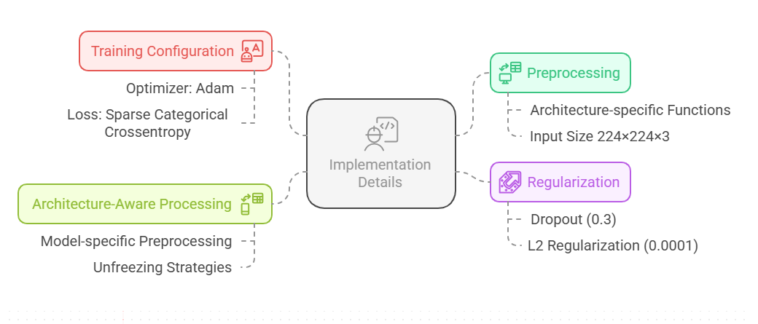
Implementation Details Processing, Regularization & Training

Slide 12
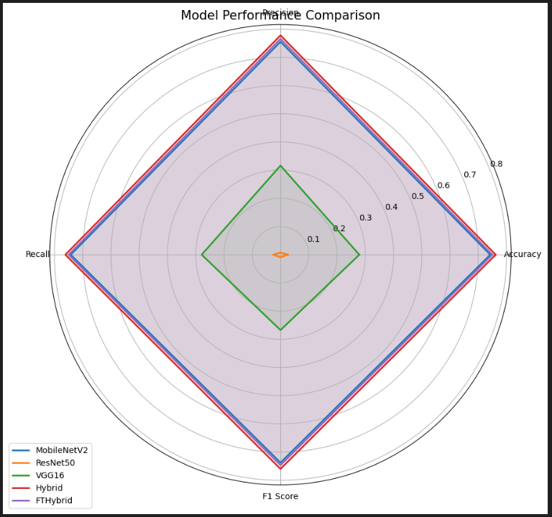
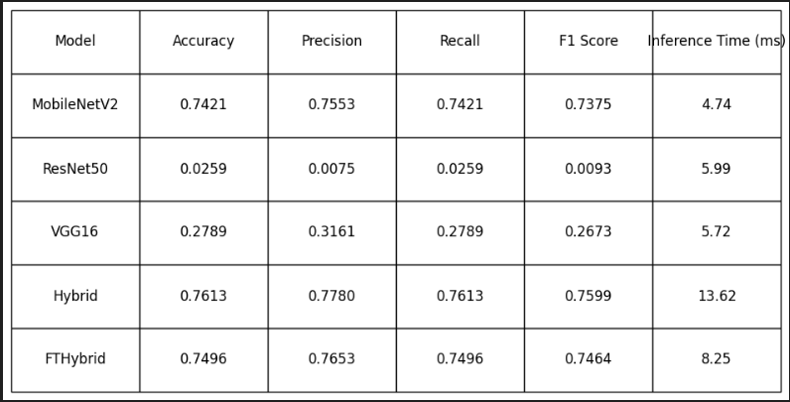
Results and Expected Outcomes
Findings:
2-model hybrid approach shows promising efficiency-performance balance
Attention mechanism effectively integrates complementary features
Model-specific unfreezing improves fine-tuning effectiveness
Expected Contributions:
Novel hybrid architecture optimizing feature integration
Systematic framework for evaluating model combinations
Fine-tuning strategies specialized for hybrid models

Slide 13
Future Work - Proposed Enhancements
Learning Rate Optimization:
Layer-specific learning rates for different components
Cosine decay with warm restarts for better convergence
Exploring More Sophisticated Feature Fusion:
Channel attention + spatial attention mechanisms
Adaptive feature pooling across network hierarchies

Slide 14
Conclusion
Summary of Approach:
Initial exploration with 3-model hybrid architecture (MobileNetV2, ResNet50, VGG16)
Refined 2-model implementation (MobileNetV2, ResNet50) for efficiency
Attention-based feature fusion for optimal integration
Model-specific progressive unfreezing for effective fine-tuning
Research Contributions:
Addresses identified research gaps in feature complementarity and integration
Provides practical framework for hybrid model development
Balances performance and computational efficiency

Slide 15
References
Pan, S. J., & Yang, Q. (2010). A survey on transfer learning. IEEE Transactions on Knowledge and Data Engineering, 22(10), 1345-1359.
Weiss, K., Khoshgoftaar, T. M., & Wang, D. (2016). A survey of transfer learning. Journal of Big Data, 3(1), 1-40.
He, K., Zhang, X., Ren, S., & Sun, J. (2016). Deep residual learning for image recognition. CVPR 2016.
Howard, A. G., et al. (2017). MobileNets: Efficient convolutional neural networks for mobile vision applications.
Feichtenhofer, C., Pinz, A., & Zisserman, A. (2016). Convolutional two-stream network fusion. CVPR 2016.
Woo, S., Park, J., Lee, J. Y., & Kweon, I. S. (2018). CBAM: Convolutional block attention module. ECCV 2018.
Kornblith, S., Shlens, J., & Le, Q. V. (2019). Do better ImageNet models transfer better? CVPR 2019.

Slide 16
Q&A
Thank You
Questions / Feedback / Suggestions?

